Slide 1

Body & Soul – Fitness App
Body Achieves What Mind Believes

Slide 2

Business Case – This App
Busy - Bee
Old is Gold
Fitness for Everyone
Focusing on professional and busy moms who cannot come to gym regularly.
Focusing on senior population. Easy going exercise with fun, providing advice towards type of exercise to be taken.
Intensive program for anybody to join and providing tailor made exercise as per person’s BMI.

Slide 3
App Structure – Program Flow
Collecting Customer Information
Name
Date
Height
Assigning Program
Busy Bee
Designing Fitness Plan
Exercise
Weight
Old is Gold
Average Joe
Diet
Online Videos
Gym Access

Slide 4
App Design
Data Collection
Calculating BMI
Data Collection Post Exercise
Feedback To & From Customer
Assigning Program as per BMI or Age
4

Slide 5
Challenges
Learn & Code
Time Management
Debugging
Testing
Assignment
How to get there? Is it doable
I think they need help
5

Slide 6
End Result
We did it !!!
Learning on the way
Running App
Scope of Improvement
Incorporate learning in next assignment
Feeling Relaxed till next assignment
Assignment
Good Job.
6

Slide 7
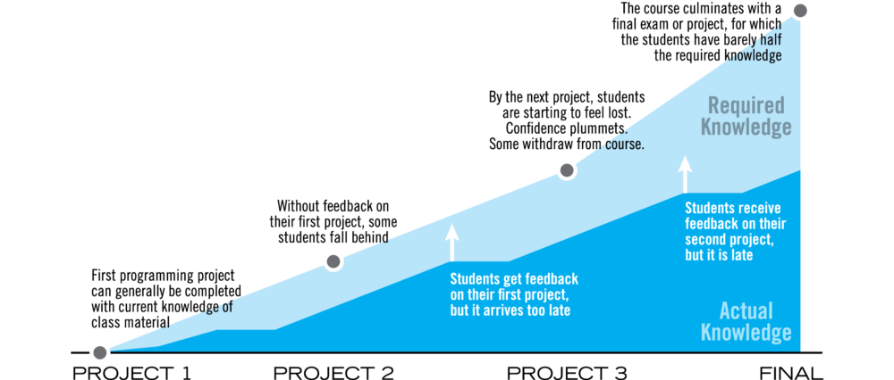
Feedback & Area of Improvement
Coding Best Practices
Critique of Code
Design Process
7

Slide 8
THANK YOU
Insert Image

